Slide 1
Lock Picking the macOS keychain OBTS v5 Oct 2022

Slide 2



Whoami?
Cody Thomas @its_a_feature_
Sr. Software Dev. at SpecterOps
Created Mythic C2 Framework
macOS Red Teamer
Instructor for Mac Tradecraft
Love-hate relationship with JXA

Slide 3
Overview
What is the macOS Keychain
Why go after the macOS Keychain
What are Keychain Items
Accessing the Keychain
3 Keychain Goodies

Slide 4
1.
What is the macOS Keychain?

Slide 5
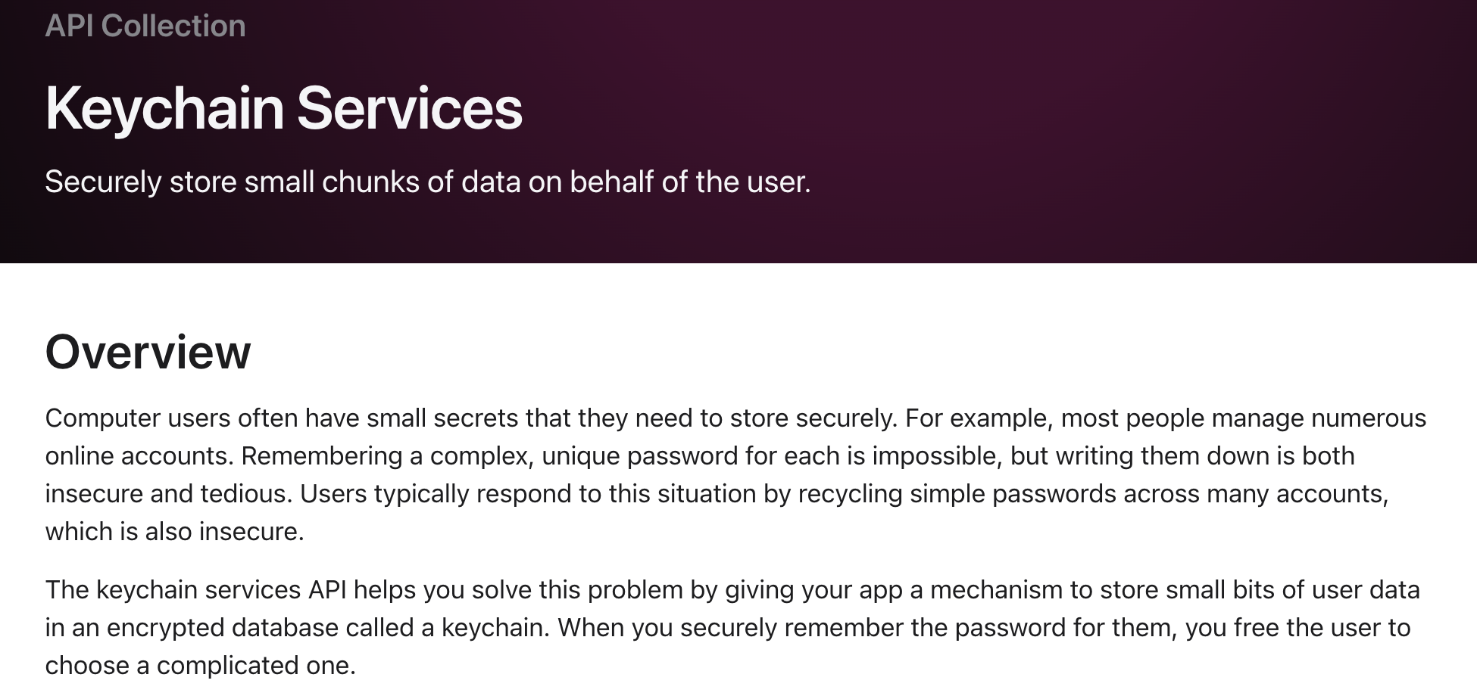
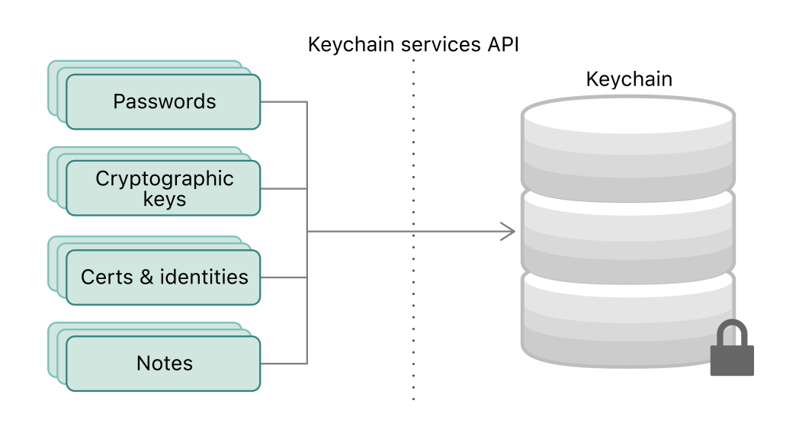
https://developer.apple.com/documentation/security/keychain_services

Slide 6
Keychain Types
Two different “kinds” of Keychains:
File-based keychain (what we’re talking about here)
macOS based
Database ”Data Protection” keychain
iOS and iCloud based

Slide 7
Two Keychains by Default
System Keychain
/Library/Keychains/System.keychain
WiFi Passwords
System Root Certificates
System Private Keys
System Application Passwords
User Keychain
~/Library/Keychains/login.keychain-db
Application Passwords
Internet Passwords
User-created Certificates
Network Passwords
User-generated Public/Private Keys

Slide 8
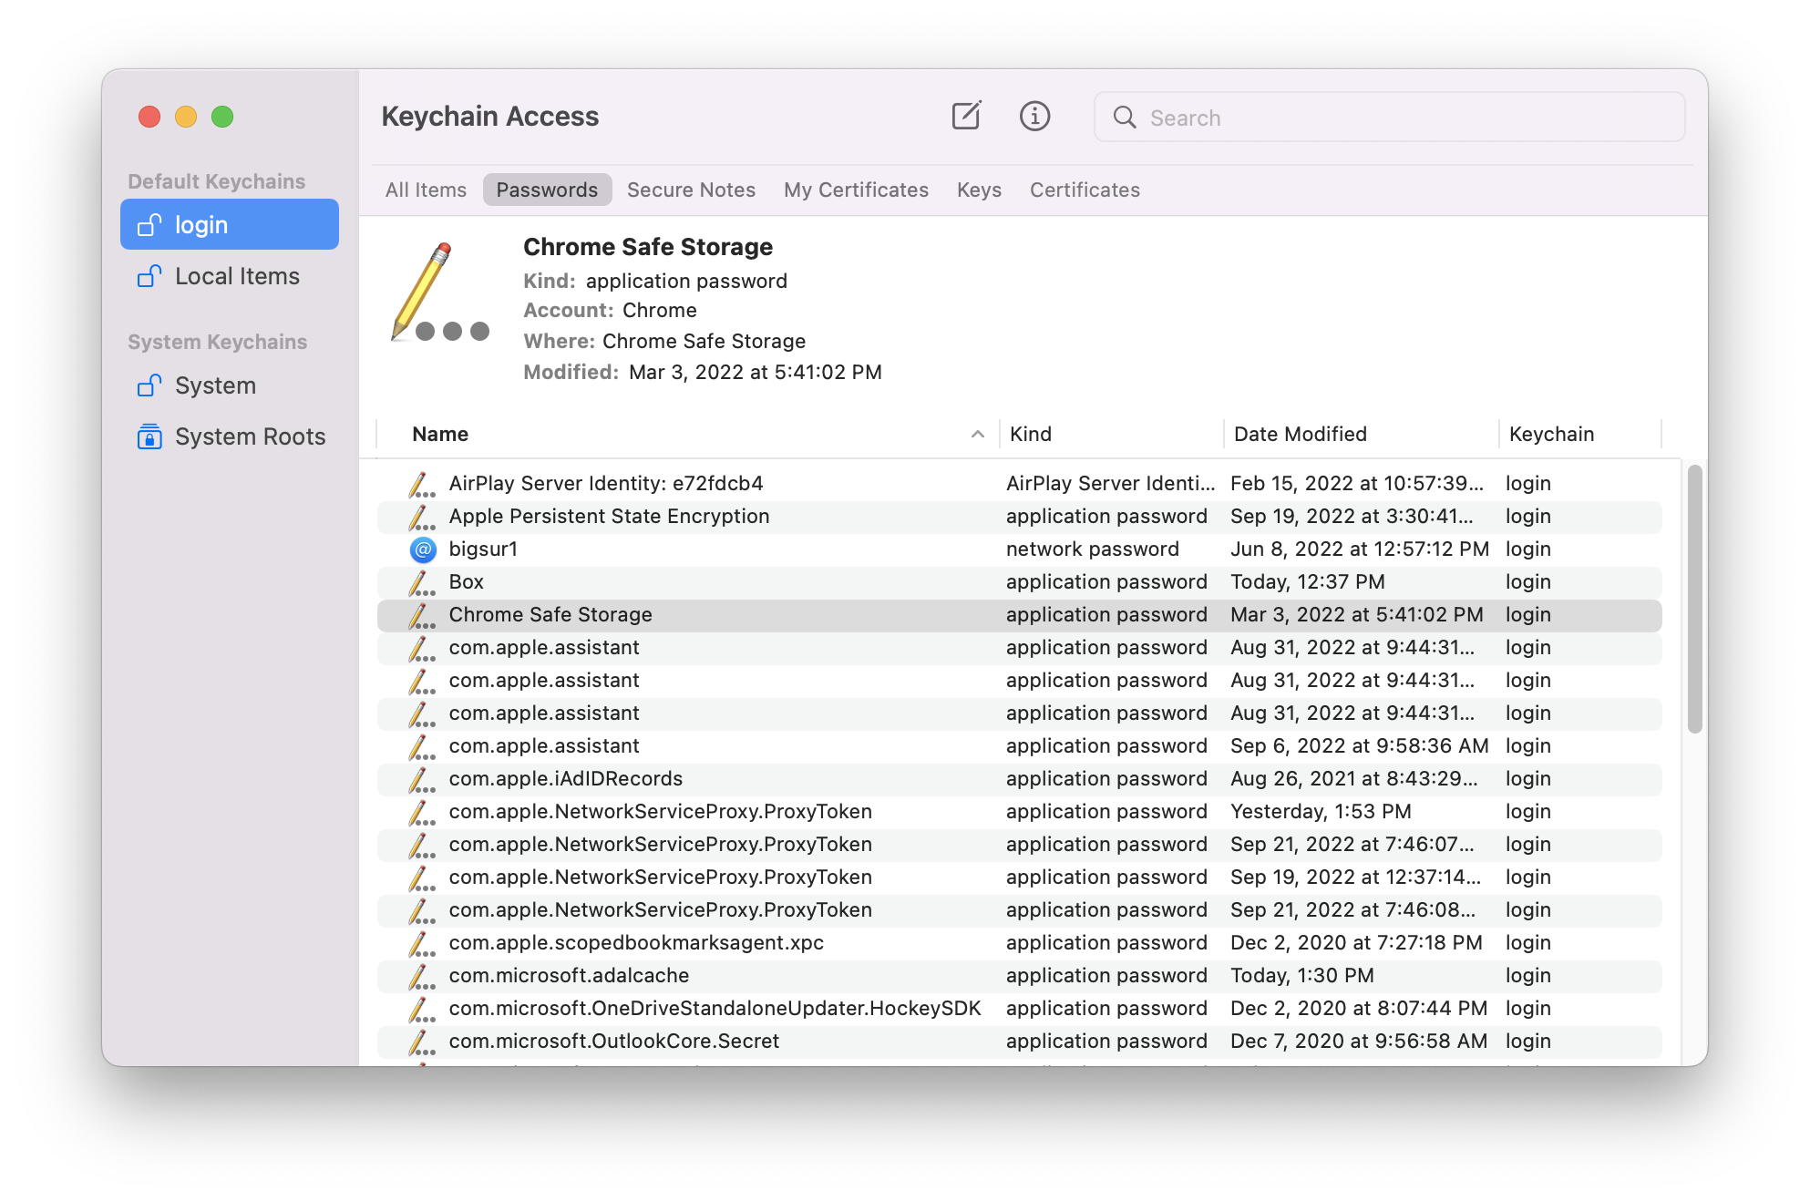
Keychain Access.app

Slide 9
2.
Why the macOS Keychain?

Slide 10
Offensive Tradecraft - current
No Apple protections around the keychain files
Download for later analysis
Metadata around entries is plaintext, but passwords are encrypted
Need the user’s plaintext password to decrypt offline file
Can be very tough to get user’s password
Chainbreaker Python GitHub Project
Want keychain entries for additional techniques
Chrome Safe Storage, Slack Safe Storage, Developer signing certificates, etc

Slide 11
Offensive Tradecraft - desire
Retrieve decrypted secrets without prompting
Even if we’re wrong about what we can get without prompting, no prompting
SecKeychainSetUserInteractionAllowed
Don’t have to know the user’s plaintext password
If we had this, we’d just do it all offline
Find misconfigurations (and abuse them)
Avoid command-line based detections
Avoid anomalous file opens on the keychain

Slide 12
Offensive Tradecraft - Tooling
Created new Objective C tool – LockSmith
Open Source on GitHub:
https://github.com/its-a-feature/LockSmith
Generates Mach-O and Dylib
Complementary LockSmithLiteJXA
Open Source on same GitHub

Slide 13
3.
What are Keychain Items?

Slide 14
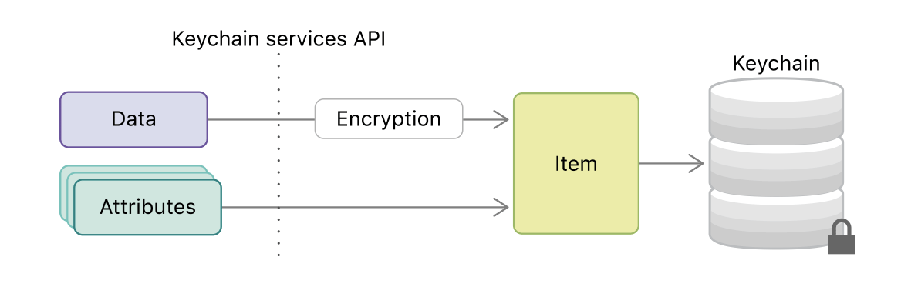
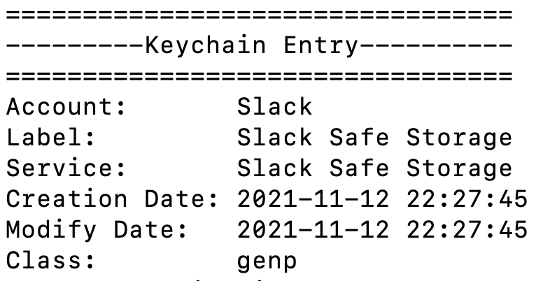
Keychain Items – 2 components
Encrypted secret
Attributes about the secret (not encrypted)
https://developer.apple.com/documentation/security/keychain_services/keychain_items?language=objc

Slide 15
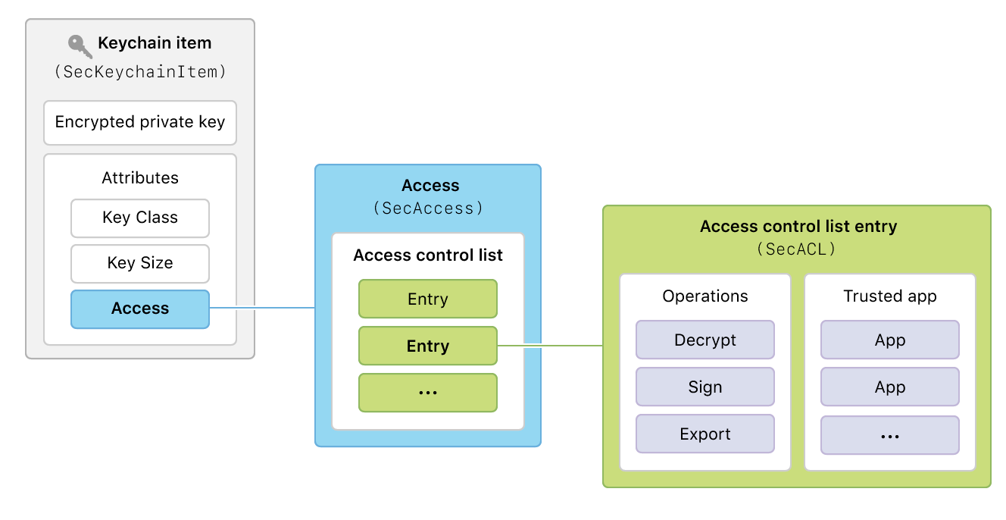
Keychain Items Access
Access Control Lists (ACLs)
Authorizations (operations) and who can do them
https://developer.apple.com/documentation/security/keychain_services/access_control_lists?language=objc

Slide 16
Keychain ACL Entries
Offensively interesting authorizations
ACLAuthorizationExportClear
ACLAuthorizationExportWrapped
ACLAuthorizationAny
Trusted Applications
List* of applications that can do the action without prompting
Can be Nil, empty list, or a list of applications

Slide 17
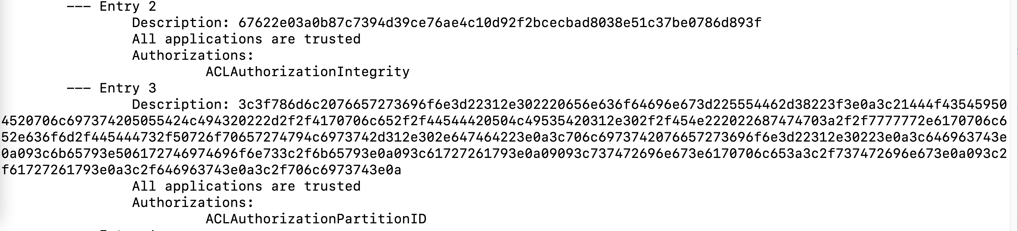
Keychain ACL Entries
ACLAuthorizationPartitionID
Super weird description

Slide 18
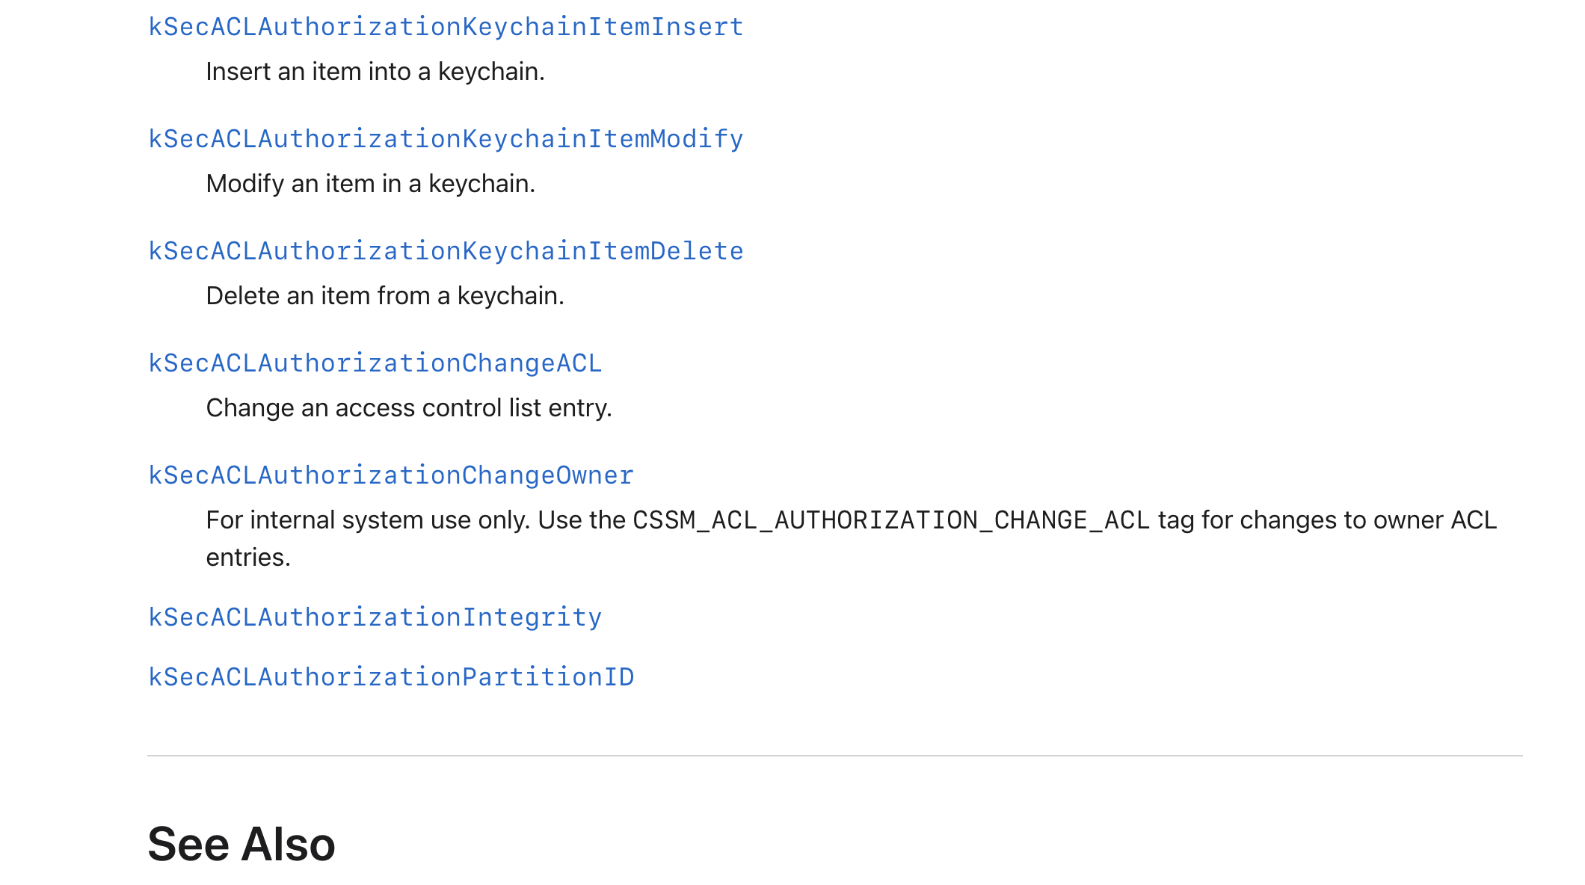
Keychain ACL Entries
ACLAuthorizationPartitionID
☹

Slide 19
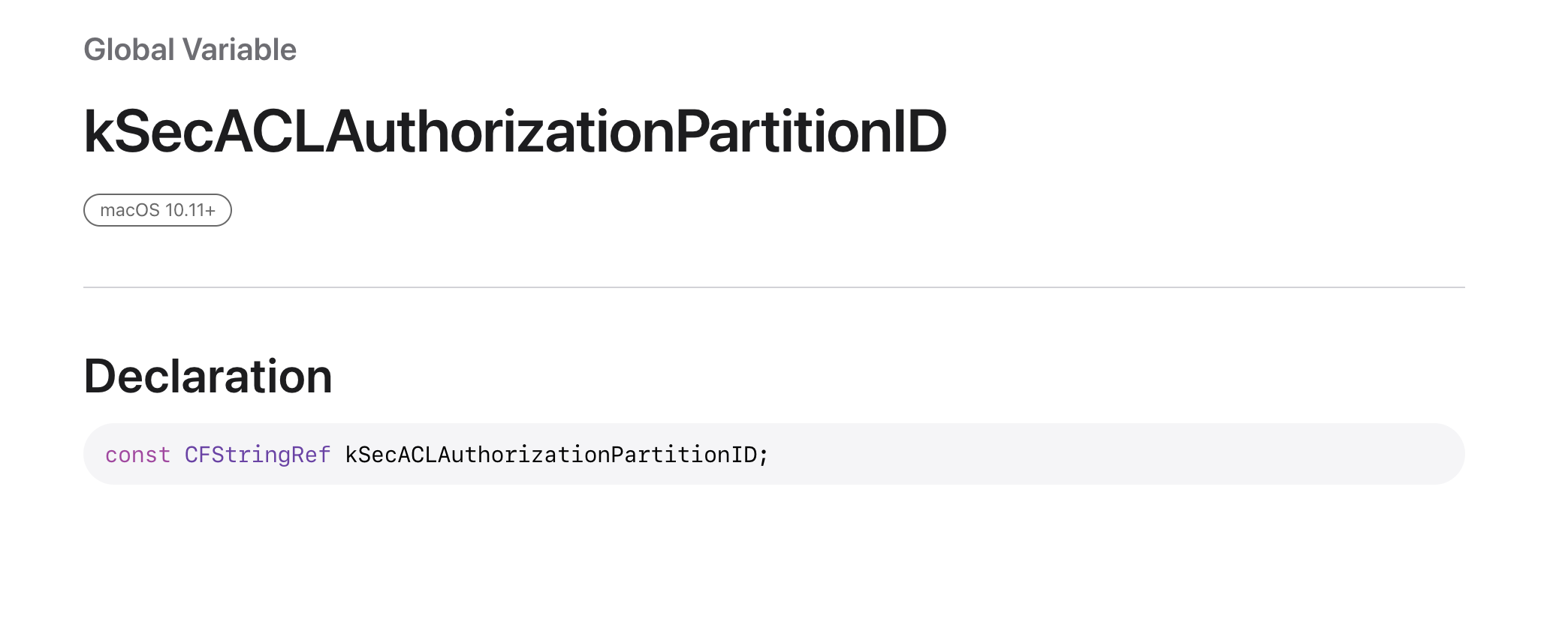
Keychain ACL Entries
ACLAuthorizationPartitionID
☹

Slide 20
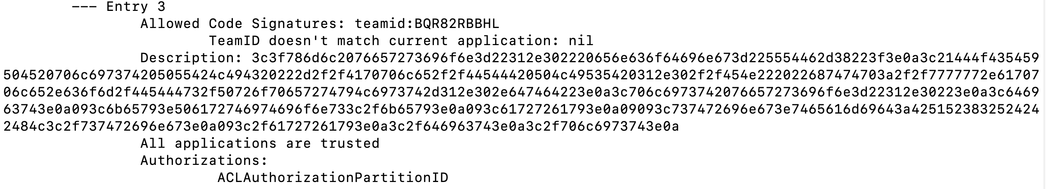
ACLAuthorizationPartitionID
Not always present (ex: not on System keychain entries)
Description is hex encoded plist with one key – Partitions
teamid: - must be signed by a certain teamid
apple: - must be signed by apple
cdhash: - must have a specific CDHash

Slide 21
Keychain Basic ACLs
New Keychain items via Keychain Access get 5 ACLs:
All applications can Encrypt
No applications can Export/Decrypt
All applications can see the Integrity Check
No applications can change ACLs
PartitionID set to apple:
Set this way to all applications can do “non dangerous” things and no applications can do “dangerous” things
“No application” means “without prompting for user consent”

Slide 22
Keychain Standard ACLs
New Keychain items from applications get 5 ACLs:
All applications can Encrypt
1+ applications can Export/Decrypt
All applications can see the Integrity Check
No applications can change ACLs
PartitionID set to teamid:[teamID here]
Set this way to all applications can do “non dangerous” things and few applications can do “dangerous” things
“No application” means “without prompting for user consent”

Slide 23
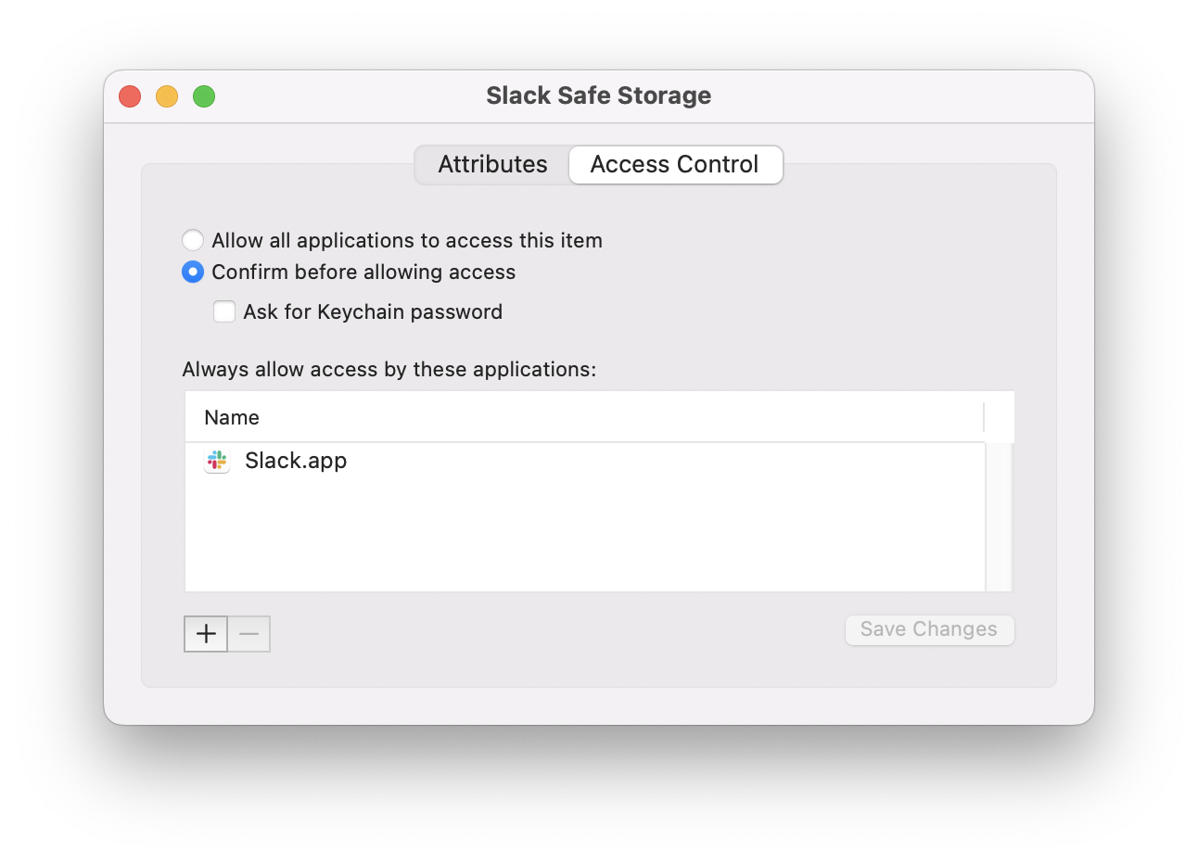
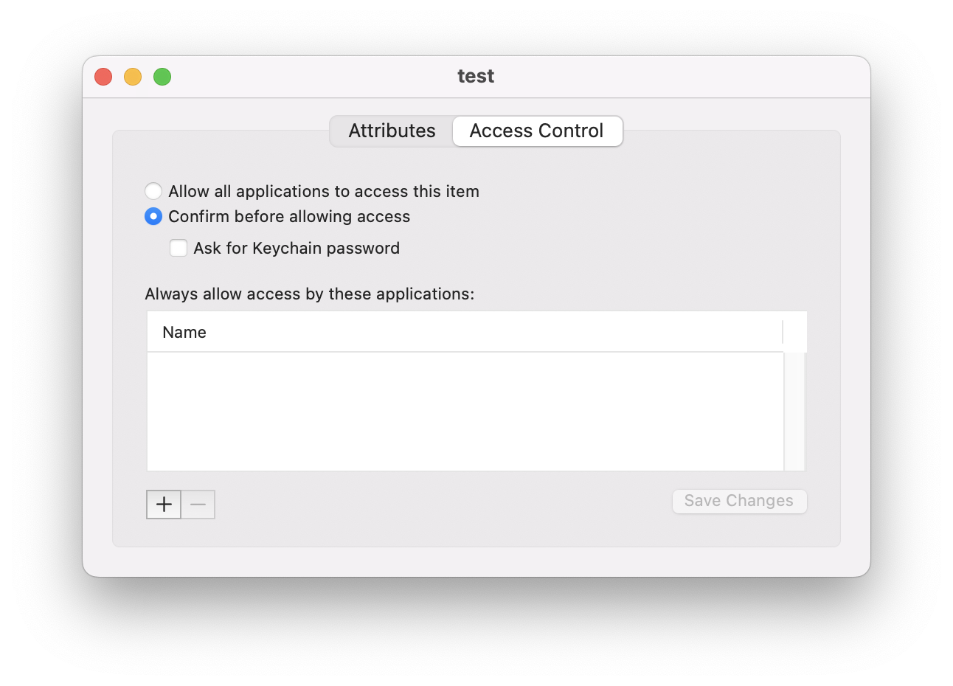
GUI Access Control Perspective
Application Password
Keychain Access

Slide 24
4.
Accessing the Keychain

Slide 25
Security built-in tool
security dump-keychain –a –d
Dump all metadata and decrypted secrets from the keychain
security find-generic-password -a “Slack” –g
Find generic passwords for the “Slack” account and print the secrets
security set-generic-password-partition-list –s “test service” –a “test account” –S “cdhash:ac48c1600ffe453258c156478a9b31af922c53a5”
Change the specified entry’s PartitionID entry

Slide 26
API - SecItemCopyMatching
Gives the generic attributes about entries
CFDictionary of search parameters
kSecReturnData – try to decrypt automatically or not
Set to False
kSecReturnRef – get reference to keychain item
Set to True
kSecReturnAttributes – get metadata about entries
kSecMatchLimit – how many results to return
kSecClass – what kind of keychain entry

Slide 27
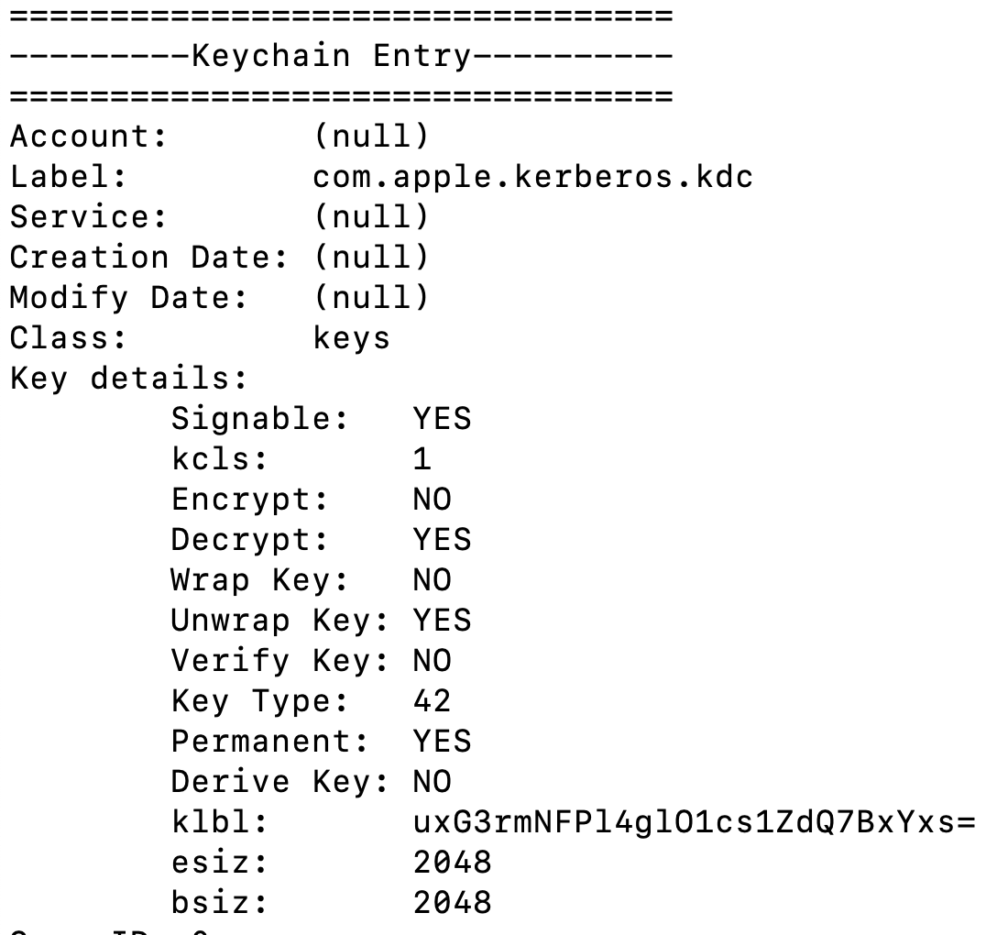
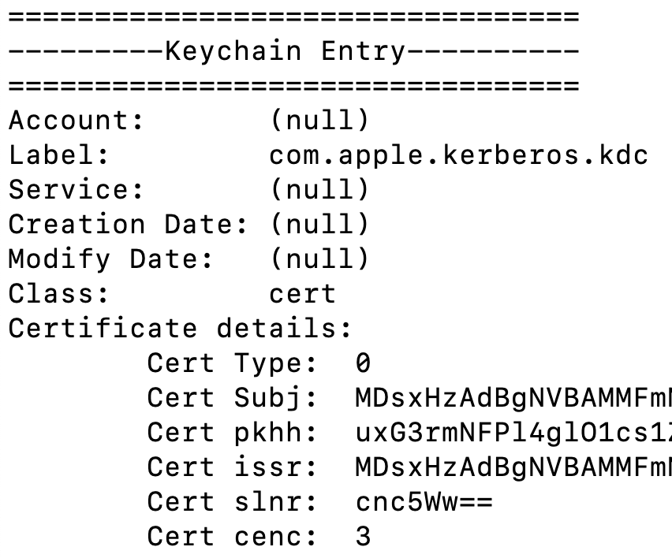
Keychain Item Attributes
Keys Certs

Slide 28
API - SecAccessCopyACLList
Get access control lists for keychain item reference
Returns list of ACLs where each has:
Description
Trusted Application List
/Applications/Slack.app
/usr/libexec/airportd
group://AirPort
Application Group
Prompt Selector
Largely ignored

Slide 29
API - Exporting Passwords
SecKeychainItemCopyContent
Gets the plaintext secret data
SecItemExport
Exports Keys and Certificates
Might have to set passwords and export encrypted

Slide 30
Operationally though…
But… so what?
That’s cool

Slide 31
Exporting Without Prompts
If 1+ trusted applications listed:
Need appropriate Authorizations
Need code signature to match PartitionID
Need code signature to match that of one trusted App
Or be a member of the right KeychainAccessGroup
If all applications trusted:
Need appropriate Authorizations
Need code signature to match PartitionIDs
If no PartitionID then truly is ALL aplications

Slide 32
Matching Apps and PartitionIDs
If 1+ trusted applications are listed:
Need to get app to load up our code somehow
DYLD_INSERT_LIBRARIES, Dylib Hijacking, etc.
What about apple: partition ID?
osascript is an apple platform binary that loads up our arbitrary code
JXA for the win!
python also works, but isn’t included by default ☹

Slide 33
5.
Keychain Goodies
Microsoft

Slide 34
Two Additional Attributes
Invisible
Boolean flag to hide Keychain entry from Keychain Access application
Only affects users trying to browse through the UI
General
Free-form string of additional metadata
Because it’s metadata, it’s not encrypted

Slide 35
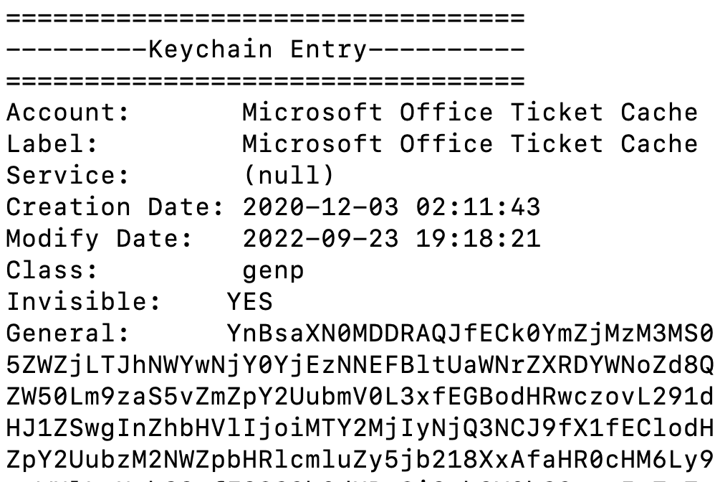
Microsoft Office Ticket Cache
Programmatically we can fetch all entries and all their metadata properties
MASSIVE General Attribute blob

Slide 36
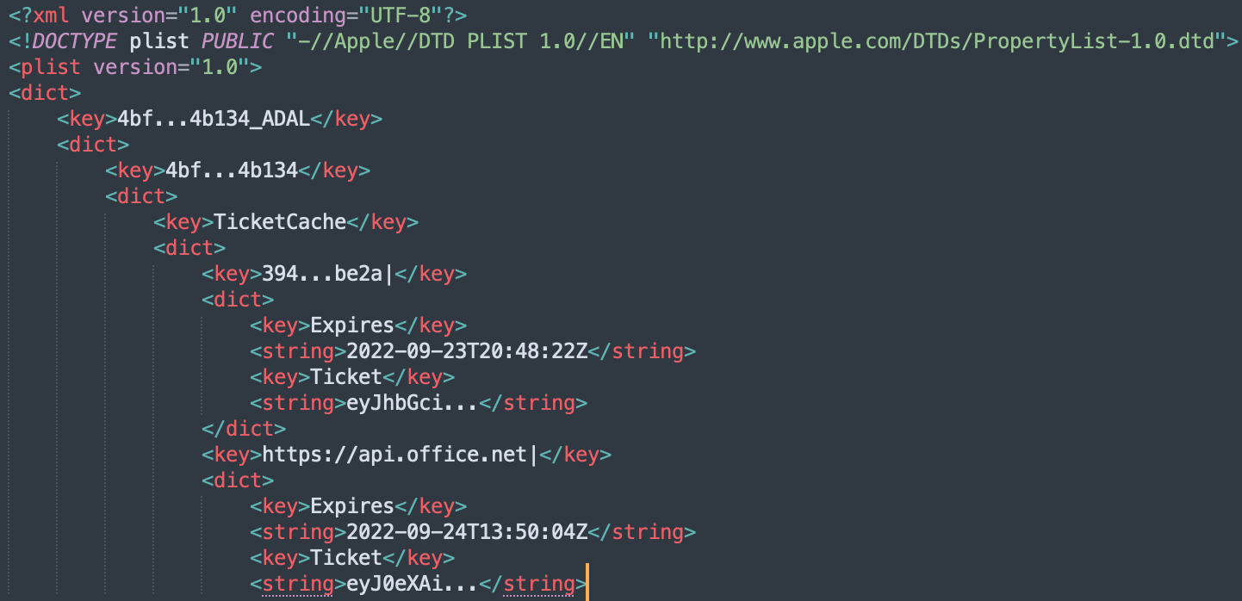
Microsoft Office Ticket Cache
Turns out to be a large binary plist
plutil –convert xml1

Slide 37
Microsoft Office Ticket Cache
JWT “tickets” for:
https://api.office.net
https://augloop.office.com/v2
https://clients.config.office.net/
https://dataservice.o365filtering.com/
https://enrichment.osi.office.net/
https://graph.microsoft.com/
https://messaging.engagement.office.com/*
https://outlook.office.com
https://outlook.office365.com/
https://pptsgs.officeapps.live.com
https://presence.teams.microsoft.com/

Slide 38
Office365.com JWT Scope
Calendars.ReadWrite
Calendars.ReadWrite.Shared
Contacts.ReadWrite
Contacts.ReadWrite.Shared
EAS.AccessAsUser.All
EopPolicySync.AccessAsUser.All
EopPsorWs.AccessAsUser.All
EWS.AccessAsUser.All
Files.ReadWrite.All
Files.ReadWrite.Shared
Group.ReadWrite.All
Mail.ReadWrite
Mail.ReadWrite.Shared
Mail.Send
Mail.Send.Shared
MailboxSettings.ReadWrite
MapiHttp.AccessAsUser.All
MessageReaction-Internal.Update
Notes.Read
Notes.ReadWrite
Oab.AccessAsUser.All
OutlookService.AccessAsUser.All
OWA.AccessAsUser.All
People.Read
People.ReadWrite
Place.Read.All
Privilege.ELT
Signals.Read
Signals.ReadWrite
SubstrateSearch-Internal.ReadWrite
Tags.ReadWrite
Tasks.ReadWrite
Tasks.ReadWrite.Shared
Todo-Internal.ReadWrite
User.ReadBasic
User.ReadBasic.All
user_impersonation
User-Internal.ReadWrite

Slide 39
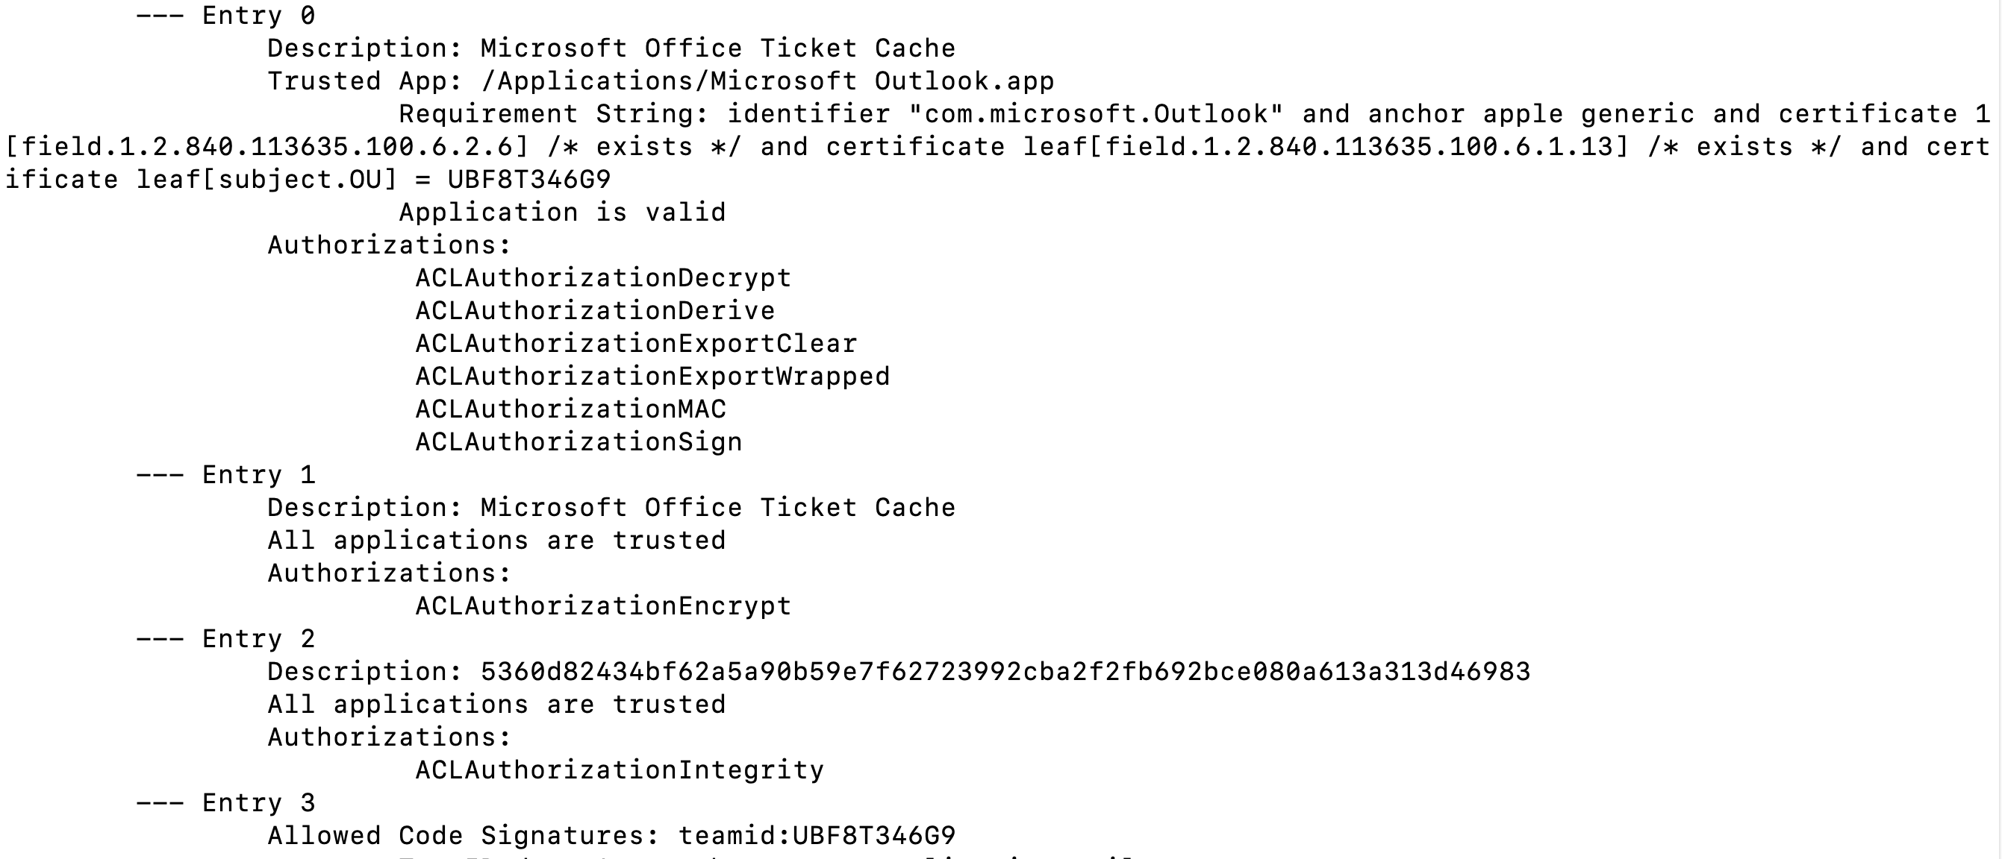
Microsoft Office Ticket Cache
ACLs – Locked down to Microsoft Outlook
What’s stored in the keychain entry then?

Slide 40
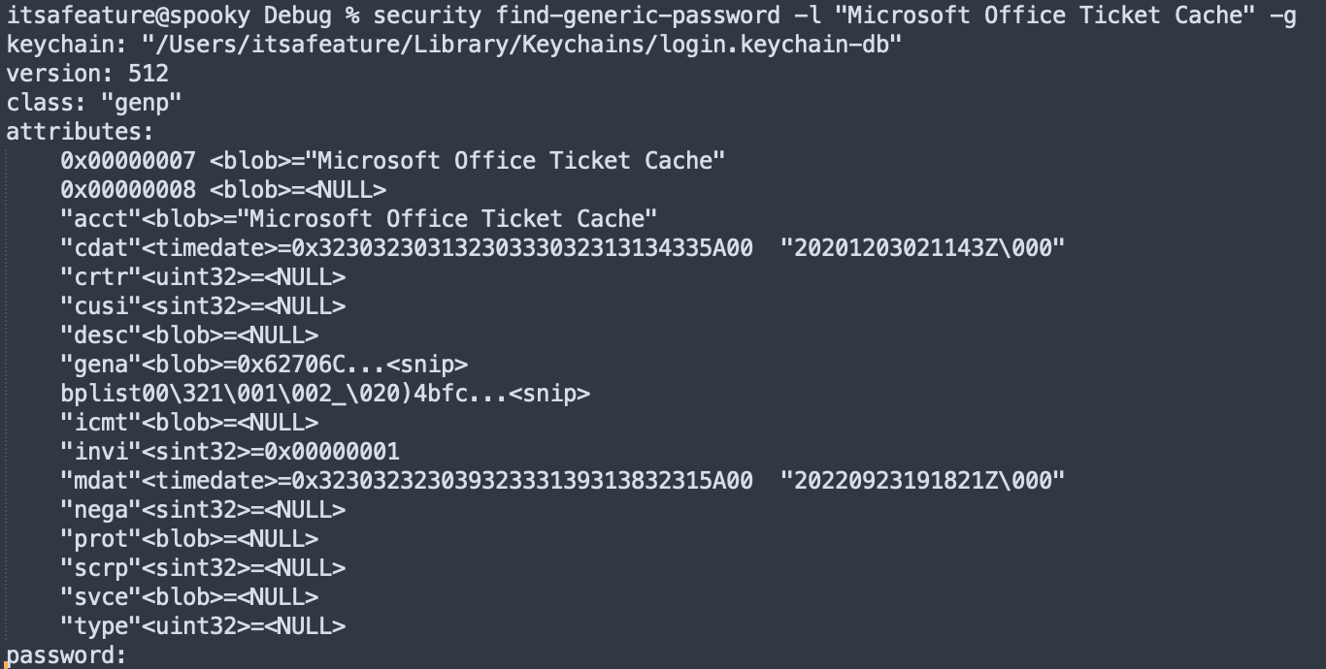
Microsoft Office Ticket Cache
Dump the entry with security tooling
IT’S EMPTY!!

Slide 41
5.
Keychain Goodies
Slack

Slide 42
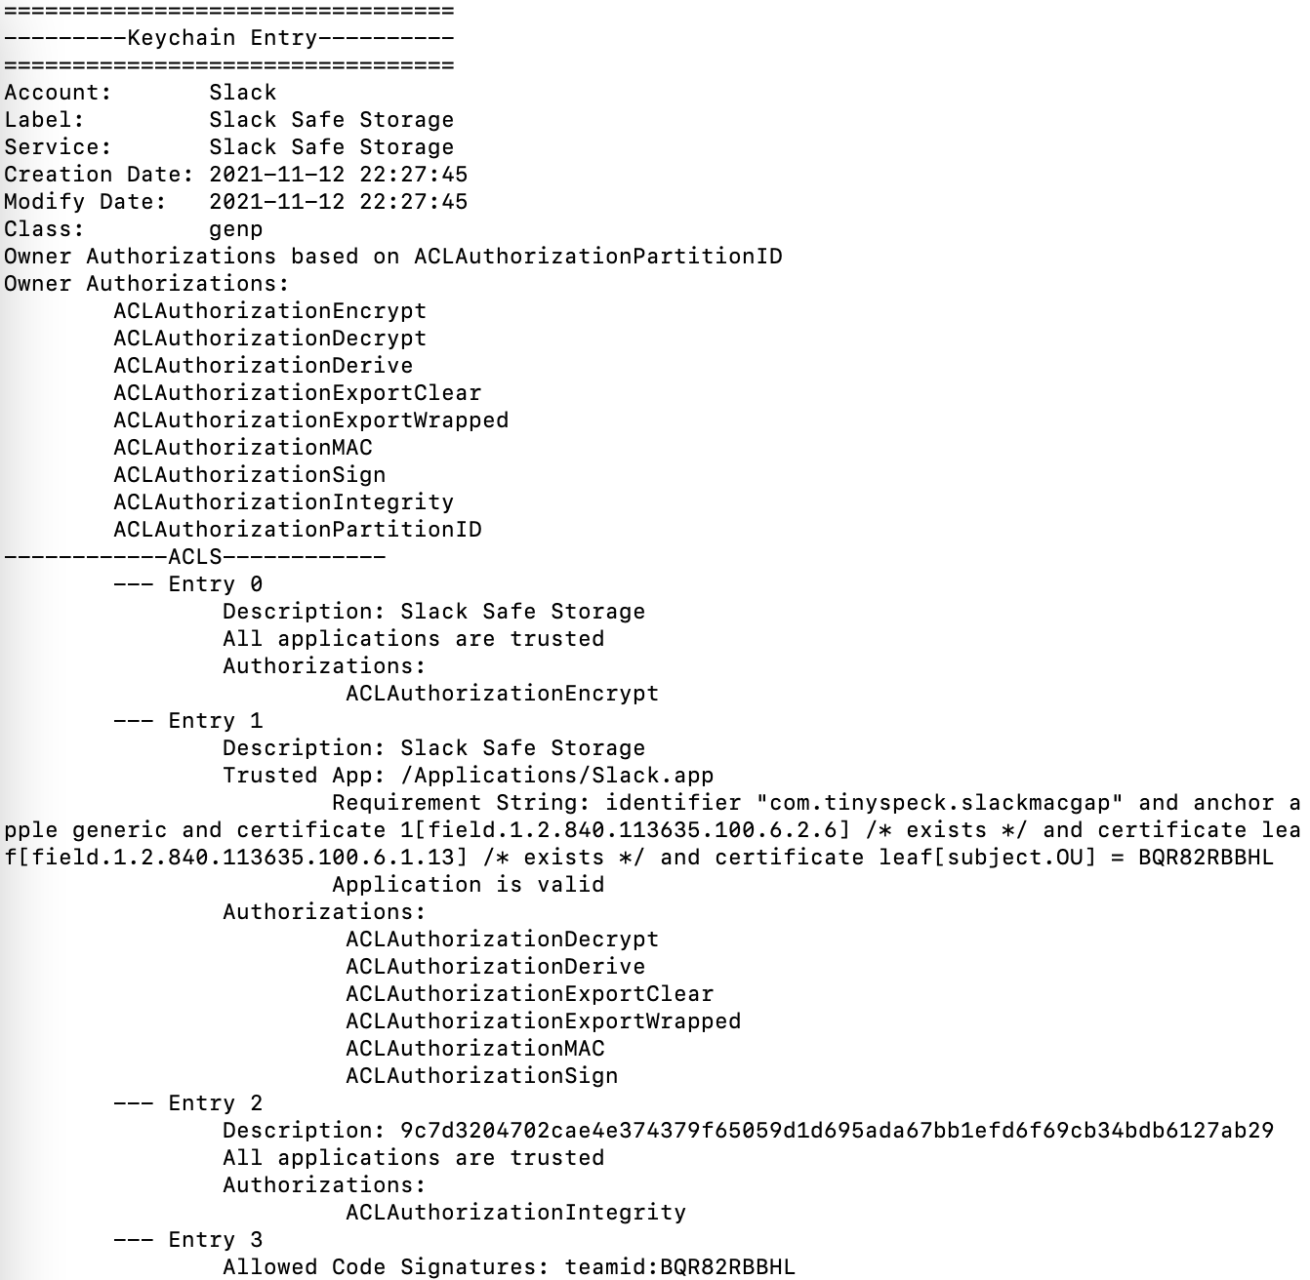
Slack App Keychain Entries
Trusted Application with requirement string
Authorizations we want
PartitionID with teamID requirements

Slide 43
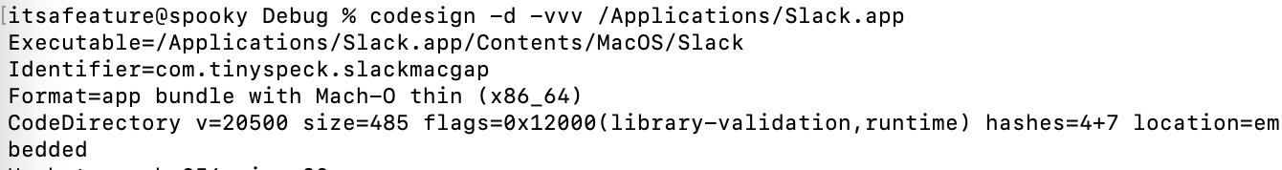
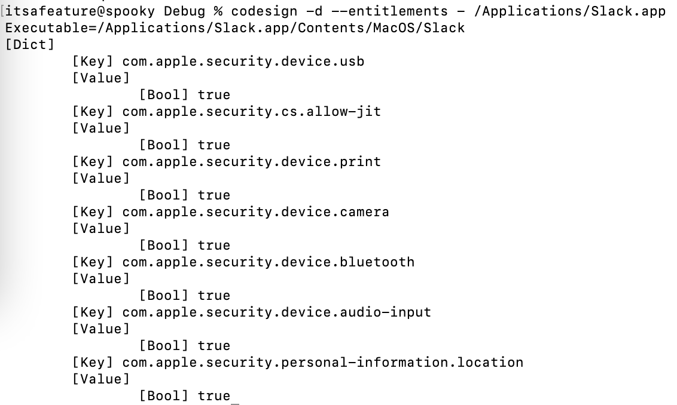
Slack App Hijacks
Current application is hardened
No vulnerable entitlements for malicious dylibs

Slide 44
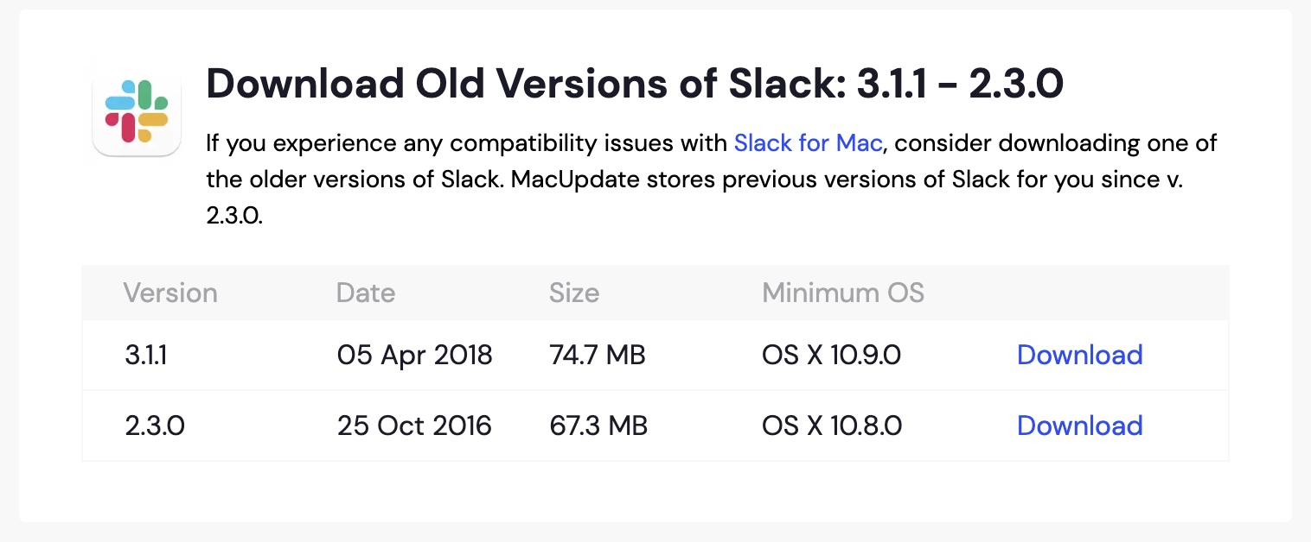
Slack App Hijacks
Hijack execution of existing app
Not easy ☹
Download older version of app
https://www.macupdate.com/app/mac/50617/slack/old-versions

Slide 45
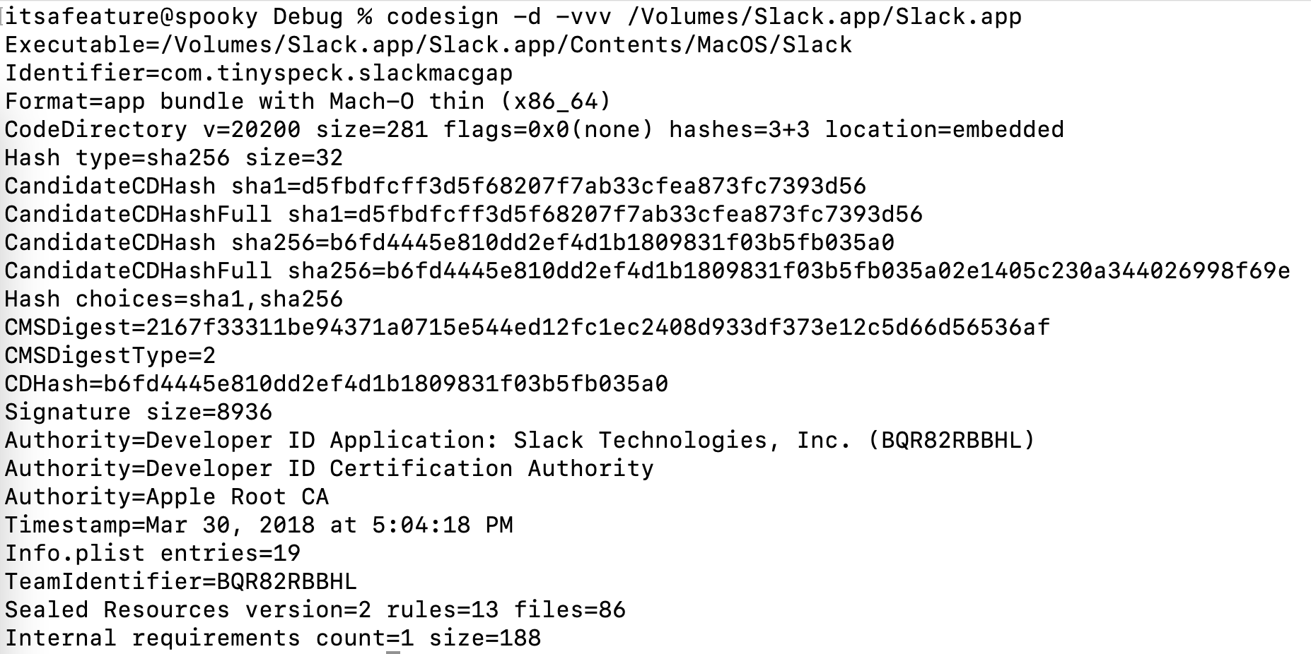
Slack App Hijacks
Bad signing / entitlements - abusable
DYLD_INSERT_LIBRARIES FTW

Slide 46
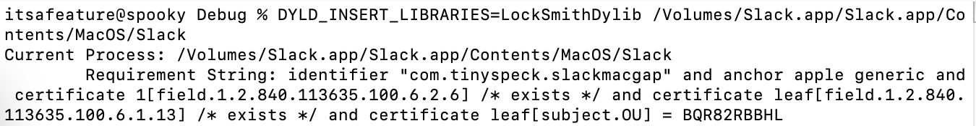
Slack App Hijacks
Code Requirements from new and old applications match
Current Slack
Old Slack

Slide 47
Slack App Hijacks
Don’t need to run from /Applications/Slack.app
Just need to match requirements string and PartitionID
Mount old Slack in /Volumes/Slack
Use DYLD_INSERT_LIBRARIES to load our Dylib
Execute our LockSmith code in the constructor

Slide 48
5.
Keychain Goodies
computer$ & com.apple.kerberos.kdc

Slide 49
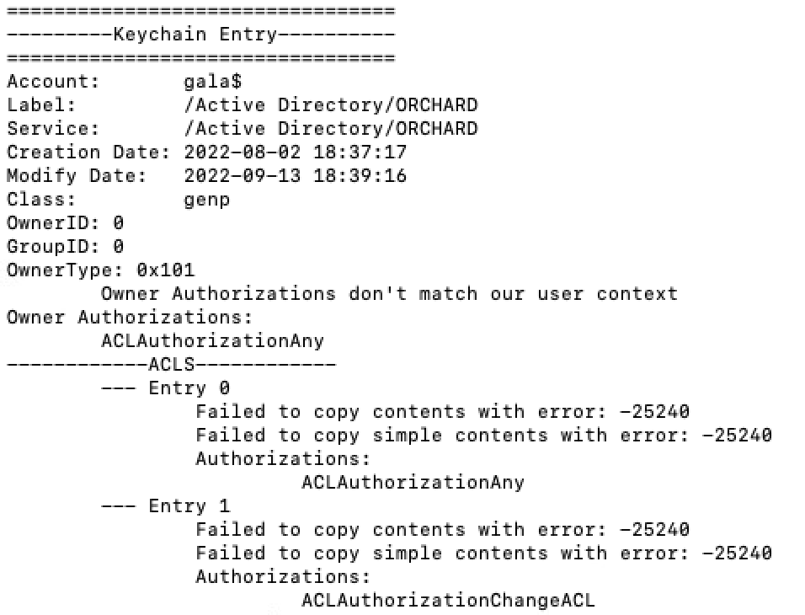
Computer$ when AD joined
Can’t always get contents of ACL entries
Suspiciously broad

Slide 50
Computer$ when AD joined
As a standard user, can’t get the plaintext password without prompting
As root, can get the plaintext password without prompting
Owner type 0x101 means the userID must match (0 in this case) and that root should be treated as a normal user account
This is expected* – normal users shouldn’t get computer$

Slide 51
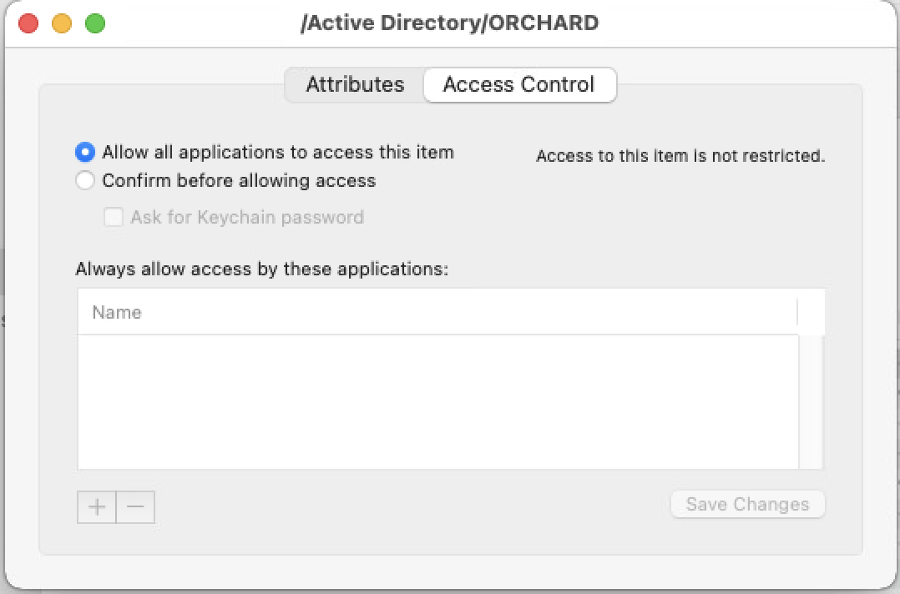
Computer$ when AD joined
Looking at the same data in the Keychain Access application shows a different story

Slide 52
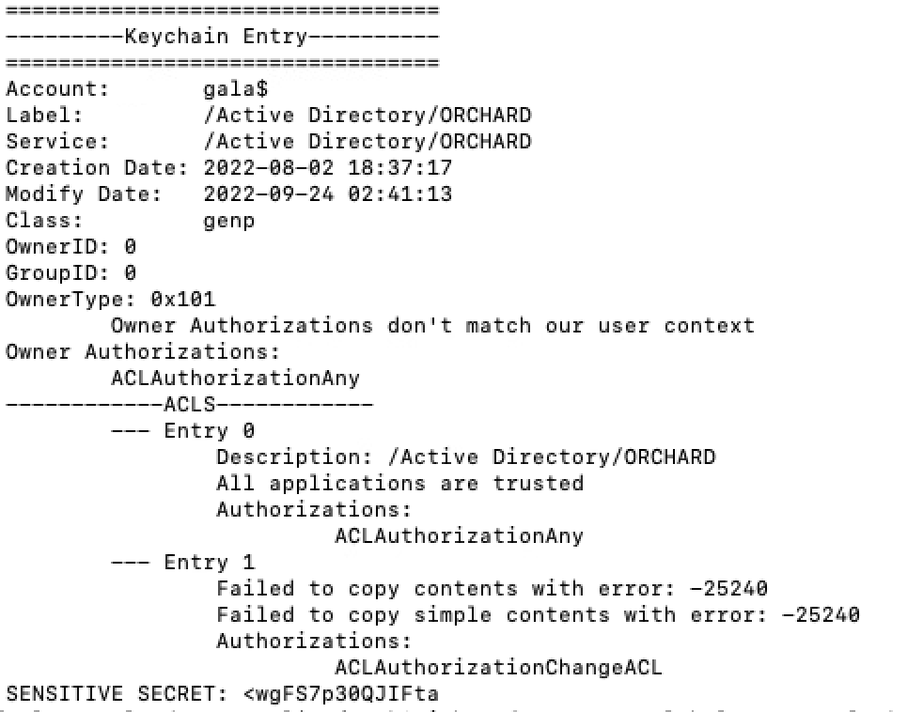
Computer$ when AD joined
If we toggle the “All applications” default access to “no applications” and back again, then save the entry, the ACLs change
Also, now standard users can export secret without prompting!

Slide 53
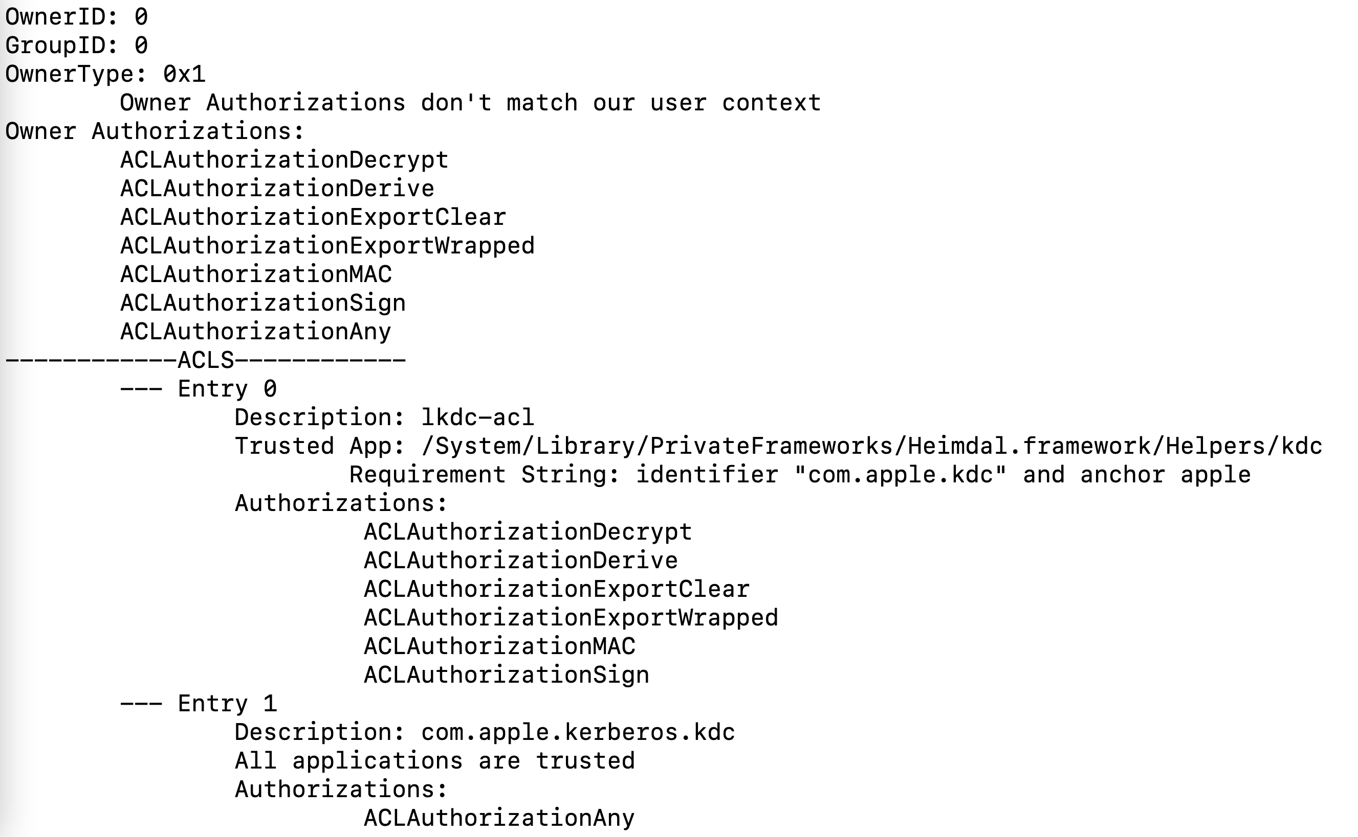
com.apple.kerberos.kdc
com.apple.kerberos.kdc PrivateKey has the same issue as computer$

Slide 54
com.apple.kerberos.kdc
com.apple.kerberos.kdc PrivateKey has the same issue as computer$
Root can export com.apple.kerberos.kdc private key, public key, and certificate without prompting
These together allow you to be any user to LKDC
LKDC handles authentication for:
Screen Sharing (VNC)
File Sharing (SMB / APFS)
Remote Management
Who resets LKDC on each mac after compromise?

Slide 55
Questions?

